Slide 1
Floating Point addition and multiplication
CSE-3109 Computer Architecture
Lecture 16

Slide 2
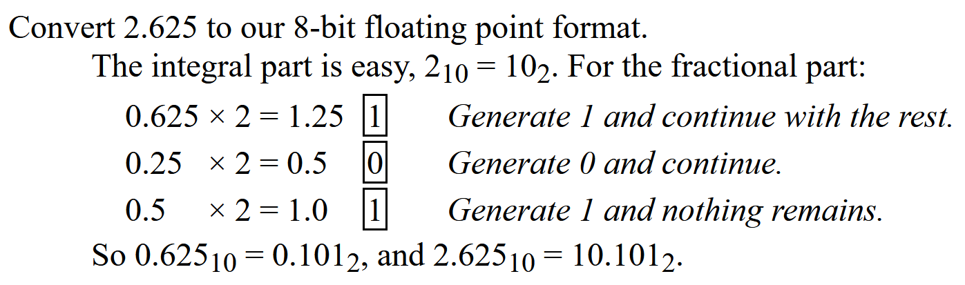
Revision

Slide 3
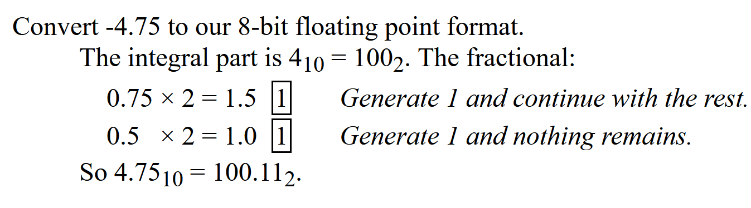
Revision

Slide 4
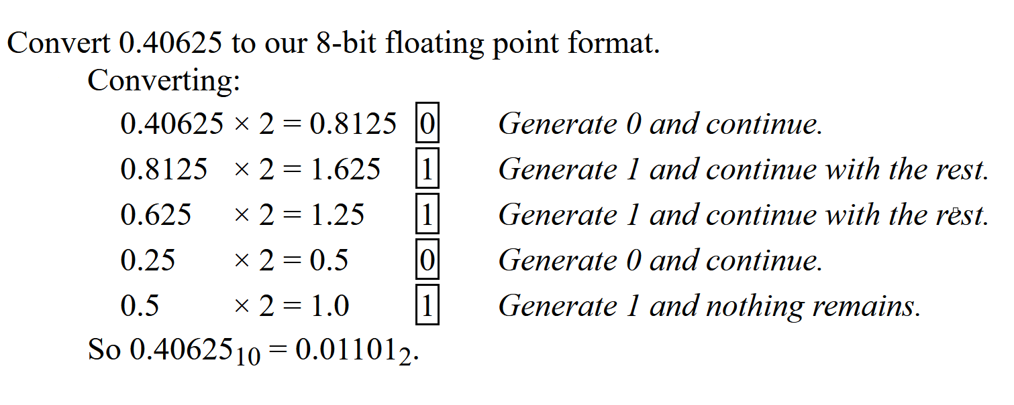
Revision

Slide 5
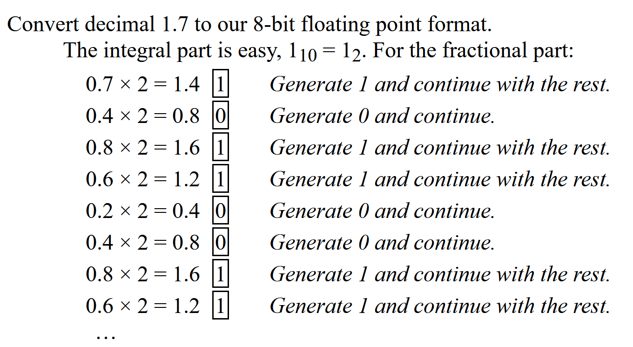
Revision

Slide 6



Floating point addition
9.999 × 10¹ + 1.610 × 10⁻¹. Assume that we can store four decimal digits of the significand and two decimal digits of the exponent.
Step 1: Align the decimal point of the number that has the smaller exponent.
After shifting, the number is
Step 2: Add the significands.
The sum is

Slide 7

Floating point addition-Continue
Step 3: Normalize the result.
Check for underflow and overflow.
Step 4: Round the result.
Truncate the number if the digit to the right of the desired point is between 0 and 4. Add 1 to the digit if the number to the right is between 5 and 9.
Exponent=8
Mantissa=23

Slide 8
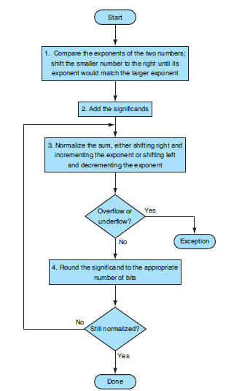
Algorithm for floating point addition

Slide 9

Example of Binary floating point addition
Add the numbers 0.5 and -0.4375 in binary.
Let’s first look at the binary version of the two numbers in normalized scientific notation, assuming that we keep 4 bits of precision:
VVI: Decimal to floating point conversion: http://sandbox.mc.edu/~bennet/cs110/flt/dtof.html

Slide 10
Continue
Step 1. The significand of the number with the lesser exponent (-1.11_{two} × 2⁻²) is shifted right until its exponent matches the larger number:
Step 2. Add the significands:

Slide 11

Continue
Step 3. Normalize the sum, checking for overflow or underflow:
Since 127 ≥ -4 ≥ -126, there is no overflow or underflow.
Step 4. Round the sum:
1.000_{two} × 2⁻⁴
The sum already fits exactly in 4 bits, so there is no change to the bits due to rounding.

Slide 12

Binary Floating-Point Multiplication
Multiplying decimal numbers in scientific notation :
1.110_{ten} × 10¹⁰ × 9.200_{ten} × 10⁻⁵.
Assume that we can store only four digits of the significand and two digits of the exponent.
Step 1. calculate the exponent of the product by simply adding the exponents of the operands together:

Slide 13
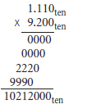

Binary Floating-Point Multiplication-continue
Step 2. Next comes the multiplication of the significands:
There are three digits to the right of the decimal point for each operand, so the decimal point is placed six digits from the right in the product significand:
Assuming that we can keep only three digits to the right of the decimal point, the product is 10.212 × 10⁵.

Slide 14
Binary Floating-Point Multiplication-continue
Step 3. This product is unnormalized, so we need to normalize it:
10.212_{ten} × 10⁵ = 1.0212_{ten} × 10⁶
At this point, we can check for overflow and underflow.
Step 4. We assumed that the significand is only four digits long (excluding the sign), so we must round the number. The number 1.0212_{ten} × 10⁶ is rounded to four digits in the significand to
1.021_{ten} × 10⁶

Slide 15
Binary Floating-Point Multiplication-continue
Step 5. The sign of the product depends on the signs of the original operands.
If they are both the same, the sign is positive; otherwise, it’s negative.
Hence, the product is
+1.021_{ten} × 10⁶
The sign of the sum in the addition algorithm was determined by addition of the significands, but in multiplication, the sign of the product is determined by the signs of the operands.

Slide 16
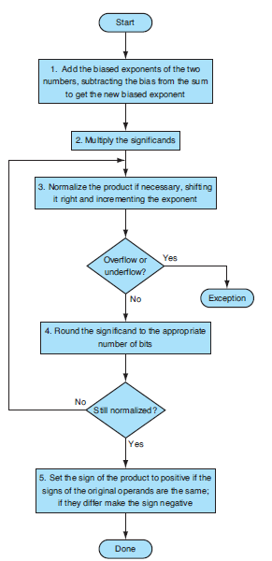
Floating-Point
Multiplication-algorithm

Slide 17

Binary Floating-Point Multiplication
Multiplying the numbers 0.5_{ten} and -0.4375_{ten},.
In binary, the task is multiplying 1.000_{two} × 2-¹ by - 1.110_{two} × 2⁻².
Step 1. Adding the exponents without bias:
-1 + (-2) = -3
Step 2. Multiplying the significands:
The product is 1.110000_{two} × 2⁻³, but we need to keep it to 4 bits, so it is 1.110_{two} × 2⁻³.

Slide 18
Binary Floating-Point Multiplication-Continue
Step 3:Now we check the product to make sure it is normalized, and then
check the exponent for overflow or underflow. The product is already normalized and, since 127 ≥ -3 ≥ -126, there is no overflow or underflow.
Step 4. Rounding the product makes no change:
1.110_{two} × 2⁻³
Step 5. Since the signs of the original operands differ, make the sign of the product negative.
Hence, the product is -1.110_{two} × 2⁻³

Slide 19
End

